Slide 1


FEA Lab Individual Project Static Structural and Explicit Dynamics Analysis of a Polygonal Model Student: Aqib Iqbal Roll No: ME-1906 Department: Mechanical Engineering Instructor: Sir Affan Software: ANSYS Workbench

Slide 2
This project presents the finite element analysis of a custom-designed polygonal structure using ANSYS Workbench. Both Static Structural and Explicit Dynamics analyses were performed. Material properties and loading conditions were uniquely defined using roll-number-based and personal parameters. A mesh convergence study was conducted to ensure numerical accuracy. The results include stress distribution, deformation patterns, and energy response, with a comparison between static and dynamic behavior.

Slide 3
Project Objectives
The main objectives of this project were:
Create a pentagon-shaped 3D solid model
Define custom material properties
Apply fixed support and remote force
Perform Static Structural analysis
Perform Explicit Dynamics analysis
Conduct a mesh convergence study

Slide 4
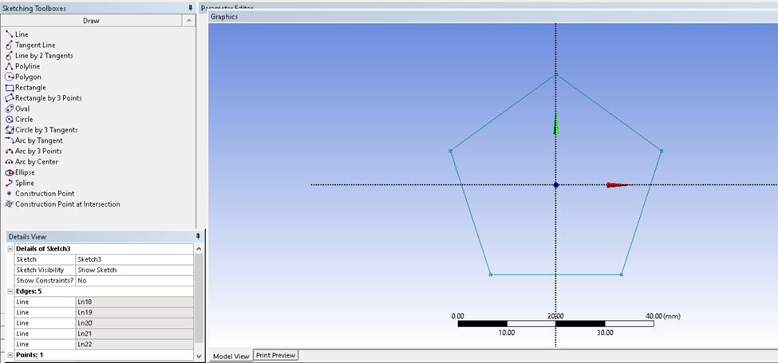
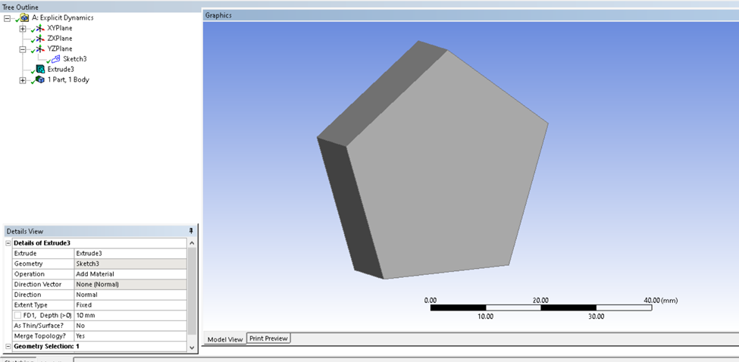
Geometry Creation
The geometry was created in ANSYS DesignModeler. A regular pentagon ( n=5) was sketched on the YZ plane and extruded to form a 3D solid suitable for structural analysis.

Slide 5
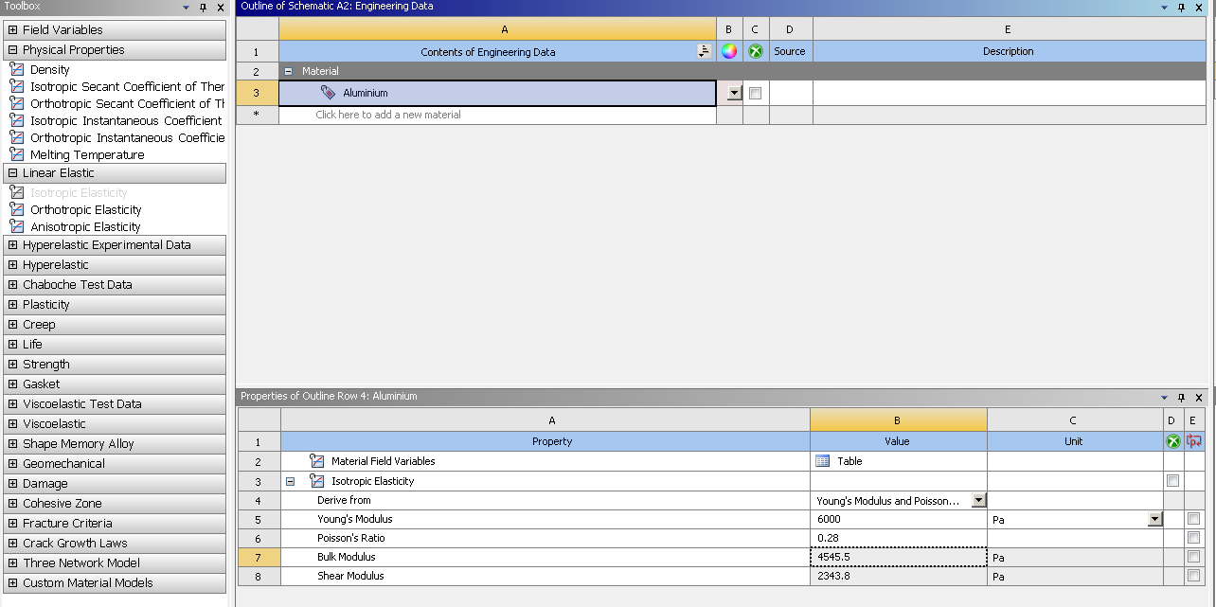
Material Properties
The material assigned to the model is Aluminum, with customized properties:
Young’s Modulus: 6000 Pa (based on roll number: 06 × 10³)
Poisson’s Ratio: 0.28
Density: Standard Aluminum

Slide 6
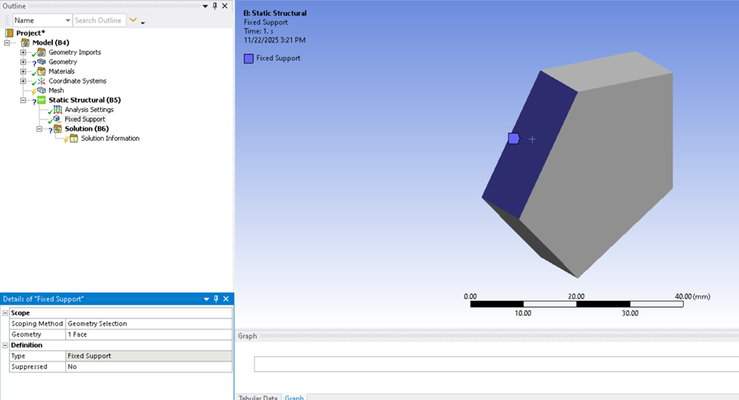
Boundary Conditions (Static Structural)
One flat face of the polygon was assigned a Fixed Support
All translational and rotational degrees of freedom were restricted

Slide 7
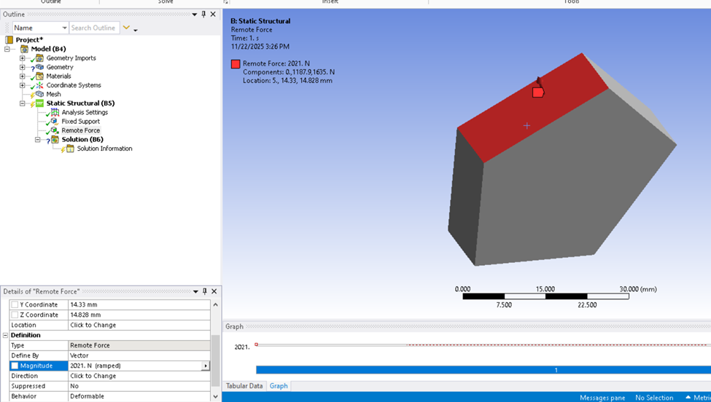
Remote Force
A Remote Force was applied at a reference point positioned at one-third of the fixed face:
Distance = 43 / 3 = 14.33 mm
Load magnitude calculated from, DOB Sum = (Day + Month + Year) = Load
Final applied load: 2021 N

Slide 8

Explicit Dynamics Loading
The same fixed support face was used Force magnitude derived from USD → PKR exchange rate
Load applied: 285N Load behavior defined as constant using a time-history table
Total simulation time: 0.2 seconds

Slide 9
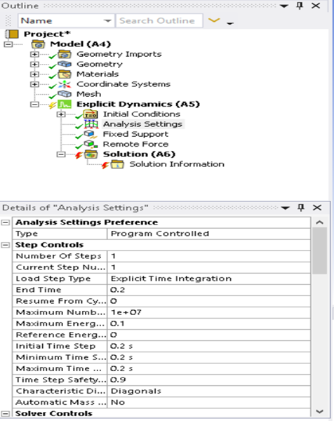
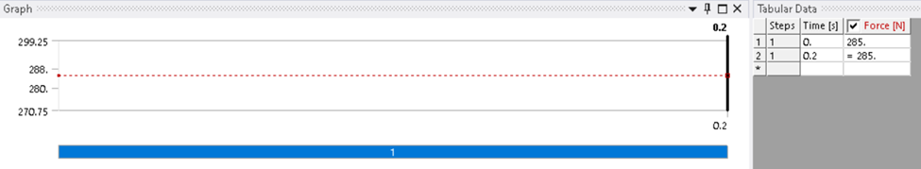

Slide 10
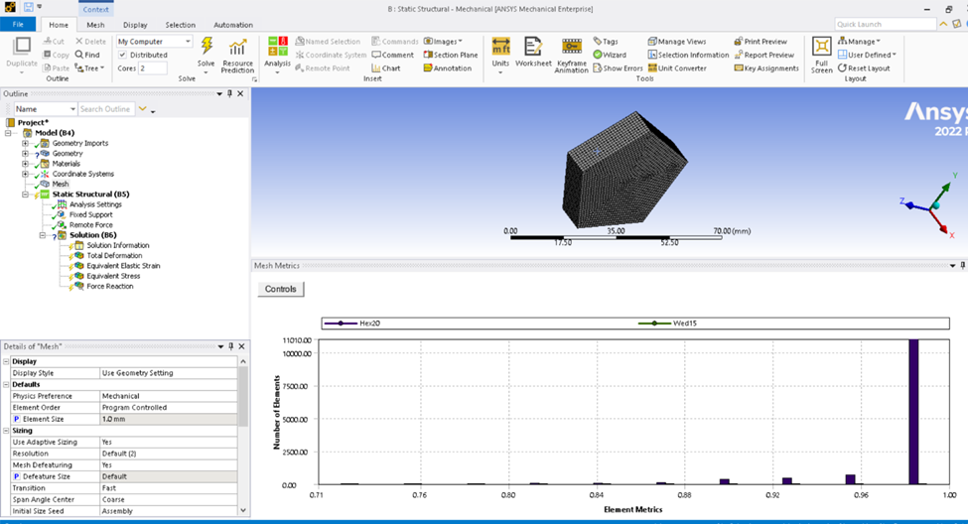
Meshing
A uniform mesh was generated with Element size: 1 mm
Element quality checked to ensure accuracy
Proper meshing is essential for reliable FEA results.

Slide 11
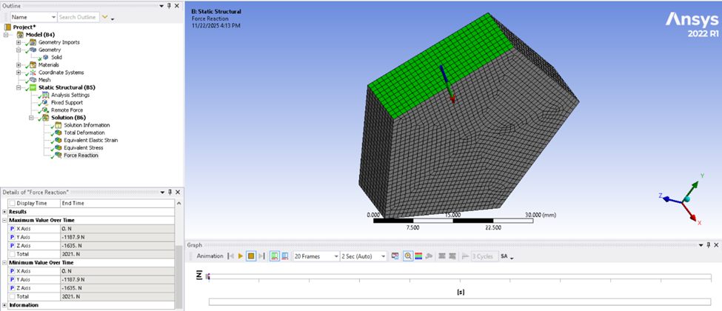
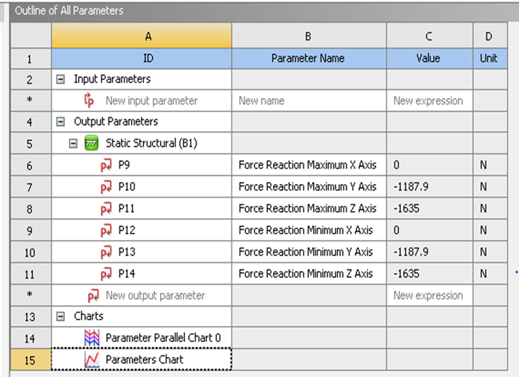
Results

Slide 12
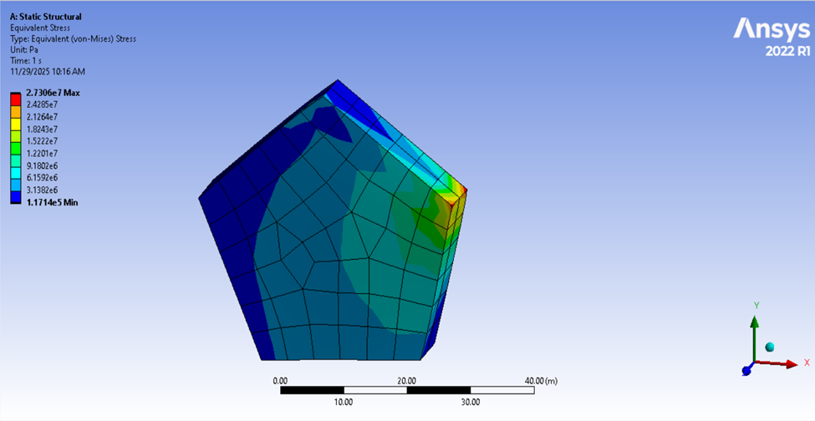
Mesh Convergence

Slide 13
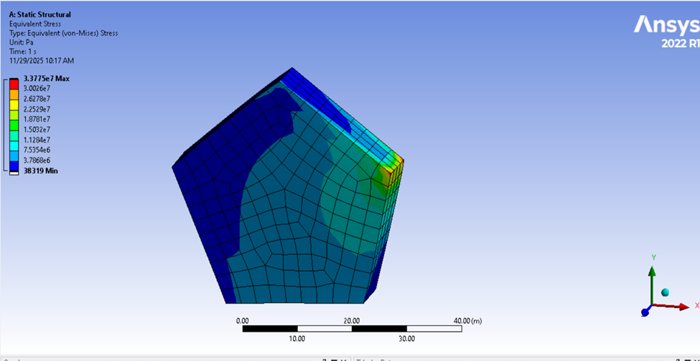

Slide 14
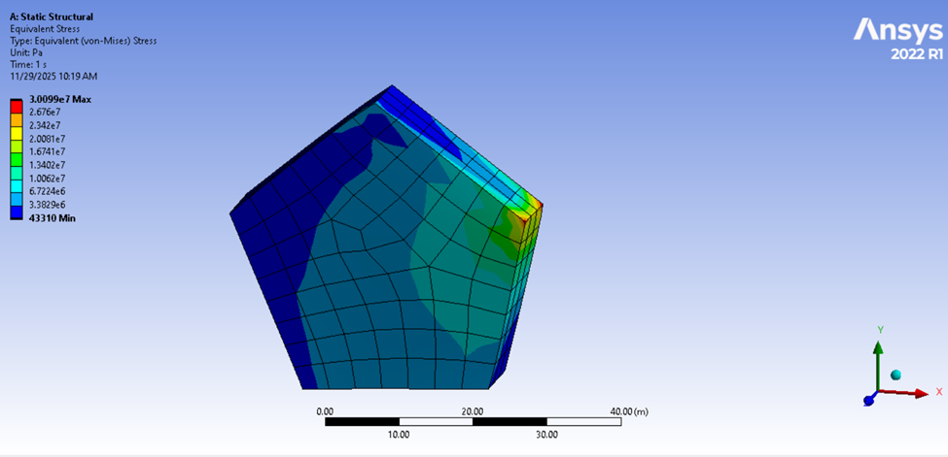

Slide 15
